Slide 1

AZ-303: Microsoft Azure Architect Technologies

Slide 2
Module 8: Implement Azure SQL Databases

Slide 3

Learning Objectives
You will learn the following:
Configure Azure SQL Database Settings
Implement Azure SQL Database Managed Instances
High availability and Azure SQL Database

Slide 4
Configure Azure SQL Database Settings

Slide 5
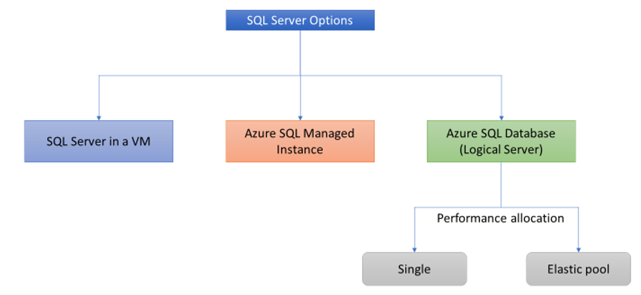
Azure SQL Database Service
Deployment Models:
Single database
Managed instance
Elastic pool

Slide 6
Demonstration: Create an Azure SQL Database single database
Create a single database
Query the database

Slide 7

Implement Azure SQL Database Managed Instance

Slide 8

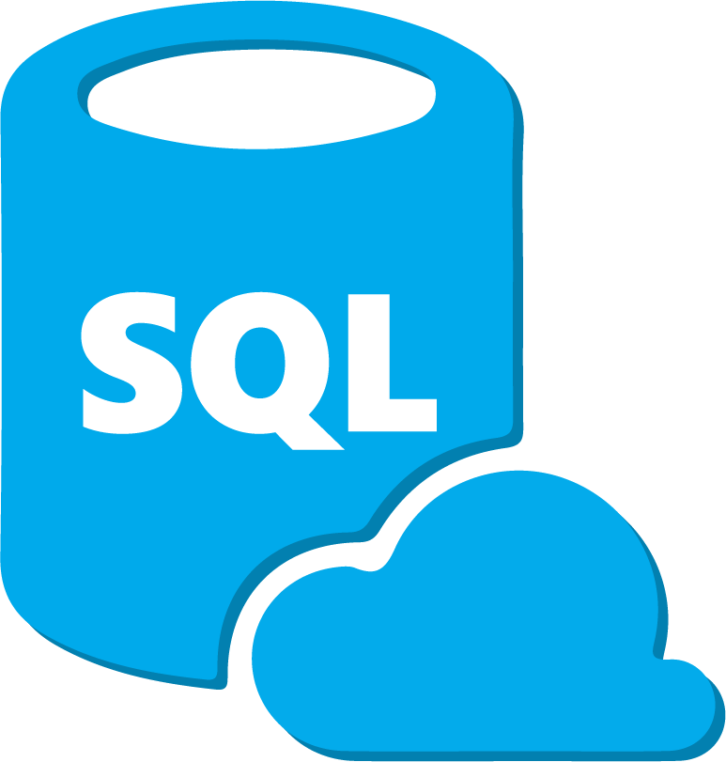


Azure SQL Database Managed Instance
SQL Database (PaaS)
New deployment option that enables frictionless migration for SQL apps and modernization in a fully managed service
Managed Instance
Single
Elastic Pool
Easy lift and shift
Fully managed PaaS
Full isolation and security
New business model
Fully-fledged SQL instance with 100% compatibility with on-premises
Built on the same PaaS service infrastructure
All PaaS features
Native VNet implementation
Private IP addresses
Competitive
Transparent
Frictionless
Notes:
Managed instance is a new deployment option of Azure SQL Database, providing near 100% compatibility with the latest SQL Server on-premises (Enterprise Edition) Database Engine, providing a native virtual network (VNet) implementation that addresses common security concerns, and a business model favorable for on-premises SQL Server customers. The managed instance deployment model allows existing SQL Server customers to lift and shift their on-premises applications to the cloud with minimal application and database changes.
The diagram outlines key features of managed instances.

Slide 9
Azure SQL Database Managed Instance (2 of 3)
PaaS benefits | Business continuity
No hardware purchasing and management No management overhead for managing underlying infrastructure Quick provisioning and service scaling Automated patching and version upgrade Integration with other PaaS data services | 99.99% uptime SLA Built in high-availability Data protected with automated backup. Customer configurable backup retention period User-initiated backups Point in time database restore capability

Slide 10
Azure SQL Database Managed Instance (3 of 3)
Feature | Description
SQL Server version / build | SQL Server Database Engine (latest stable)
Managed automated backups | Yes
Built-in instance and database monitoring and metrics | Yes
Automatic software patching | Yes
The latest Database Engine features | Yes
Number of data files (ROWS) per the database | Multiple
Number of log files (LOG) per database | 1
VNet - Azure Resource Manager deployment | Yes
VNet - Classic deployment model | No
Portal support | Yes
Built-in Integration Service (SSIS) | No - SSIS is a part of Azure Data Factory PaaS
Built-in Analysis Service (SSAS) | No - SSAS is separate PaaS
Built-in Reporting Service (SSRS) | No - use Power BI paginated reports instead or host SSRS on Azure VM.

Slide 11
Demonstration: Create an Azure SQL Database Managed Instance
Create a managed instance

Slide 12
High availability and Azure SQL Database

Slide 13
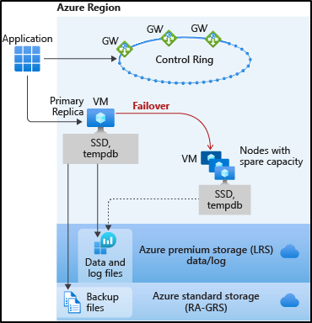
High availability and Azure SQL Database (1 of 4)
Two high-availability models used in Azure SQL database:
Standard availability model that is based on a separation of compute and storage
Premium availability model that is based on a cluster of database engine processes
Basic, standard, and general-purpose service tier availability:
Stateless compute layer
Stateful data layer

Slide 14
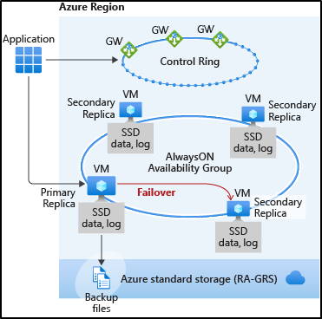
High availability and Azure SQL Database (2 of 4)
Premium and business critical service tier availability

Slide 15
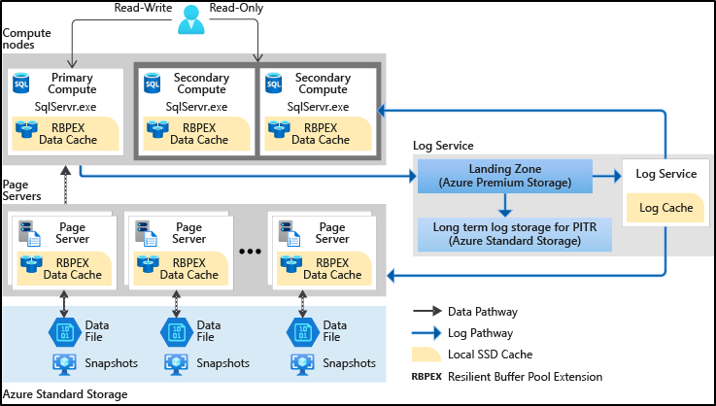
High availability and Azure SQL Database (3 of 4)
Hyperscale service tier availability

Slide 16
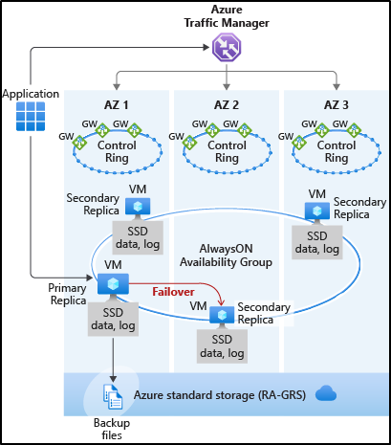
High availability and Azure SQL Database (4 of 4)
Zone redundant configuration

Slide 17

Module Review Questions

Slide 18
Online Role-based training resources: Microsoft Learn https://docs.microsoft.com/en-us/learn/

Slide 19
Thank you.

